Slide 1


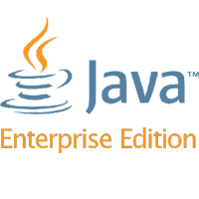
Introduction to Java EE
Java Platform, Java EE, Servlets
SoftUni Team
Technical Trainers
Software University
http://softuni.bg

Slide 2
Table of Contents
Java Platform
Java Enterprise Edition
Apache TomEE
Context & Dependency Injection
Java Servlets

Slide 3
Questions
sli.do #java-web

Slide 4
Java Platform
The Big Picture

Slide 5



Java - The Big Picture
The Java Technology is both a programming language and a
platform
The Java programming language:
Object-oriented
C-like syntax
The Java platform:
Environment
Where Java applications run

Slide 6
Java - The Big Picture (2)
There are 4 Java platforms:
Java SE (Standard Edition)
Java ME (Micro Edition)
Java FX (Effects)
Java EE (Enterprise Edition)

Slide 7
Java - The Big Picture (3)
Each Java platform:
Provides a JVM & an API
Runs applications on any compatible system
Is completely independent
Provides all of the advantages of the
Java programming language
Java SE
Java ME
Java FX
Java EE

Slide 8
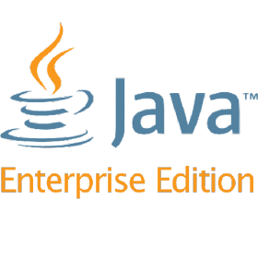
Java Enterprise Edition
Diving into the depths of Java EE

Slide 9


Java Platform, Enterprise Edition
Java EE
Formerly (J2EE), Currently Jakarta EE
A set of specifications extending Java SE
Defined by its specification
Defines APIs and their interactions
Used in various contexts, including:
E-commerce, Accounting, Banking Systems, etc.

Slide 10


Java EE vs Java SE
Java SE
Provides APIs to handle collections
JVM is the container for Applications
The container provides lower-level services
Java ЕE
Provides APIs to handle transactions, persistence, security, messaging, etc.
Applications are ran on a specific container
The container provides higher-level services

Slide 11

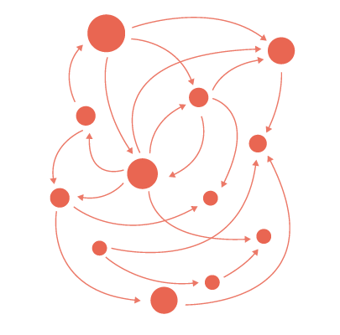

Java EE simplifies
Enterprise Applications:
Have powerful functionalities
Tend to be heavy and complex
Java EE reduces complexity
Provides a programming model
Provides a Runtime environment
Provides various APIs

Slide 12





Java EE Architecture
Container
Services
Provides
Provides
Managing
Deployment
Consumed by
Packaging
APIs
Applications

Slide 13

Maven Dependencies
pom.xml
<dependency>
<groupId>javax</groupId>
<artifactId>javaee-api</artifactId>
<version>8.0</version>
</dependency>

Slide 14

Java Community Process
The JCP is the mechanism for developing standard technical
specifications for Java technology.
https://jcp.org/en/home/index

Slide 15

Apache TomEE

Slide 16




What is a Apache TomEE?(1)
Apache TomEE (pronounced "Tommy") is the Java Enterprise Edition of Apache Tomcat (Tomcat + Java EE = TomEE) .
Developed by the Apache Software Foundation

Slide 17

What is a Apache TomEE?(2)
Combines several Java enterprise projects including:
Apache OpenEJB(Enterprise JavaBeans):
An open source, embeddable and lightweight EJB Container
System and EJB Server.
Has been integrated with Java EE application servers such as
Geronimo and WebObjects.

Slide 18

What is a Apache TomEE?(3)
Apache OpenJPA:
An open source implementation of the Java Persistence API
specification.
It is an object-relational mapping(ORM) solution for the Java
language, which simplifies storing objects in databases.

Slide 19

What is a Apache TomEE?(4)
Apache MyFaces:
An Apache Software Foundation project that creates and
maintains an open-source JavaServer Faces implementation,
along with several libraries of JSF components that can be
deployed on the core implementation.

Slide 20
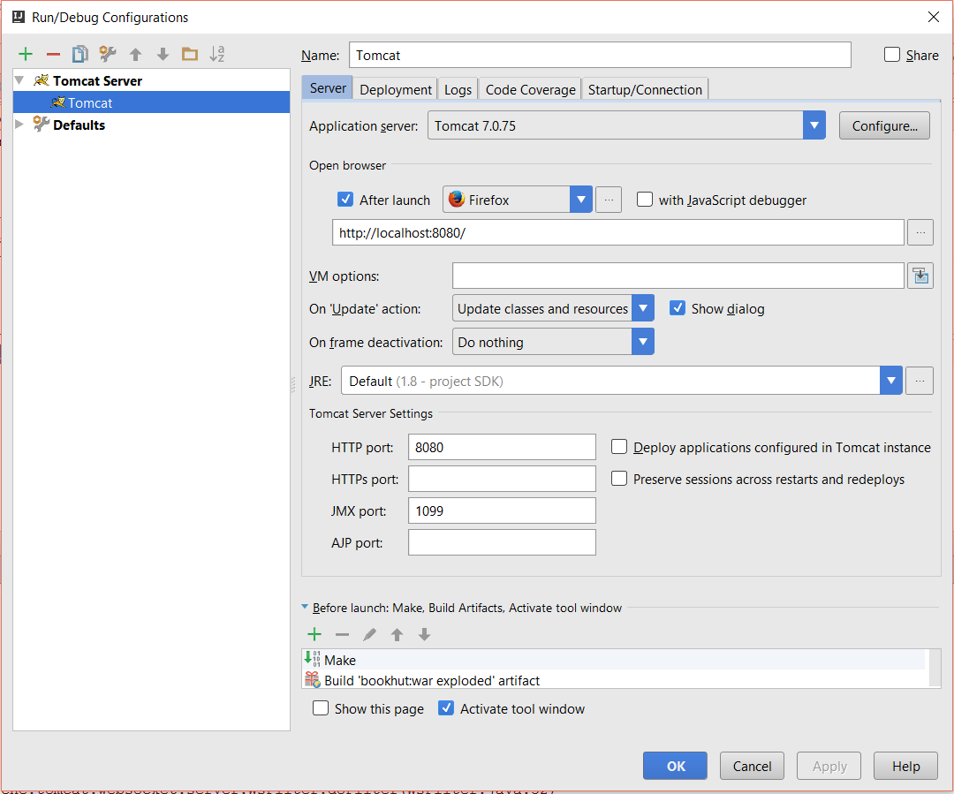

Tomcat Setup
Add Tomcat
Tomcat Server
URL
Default Action
HTTP Port

Slide 21
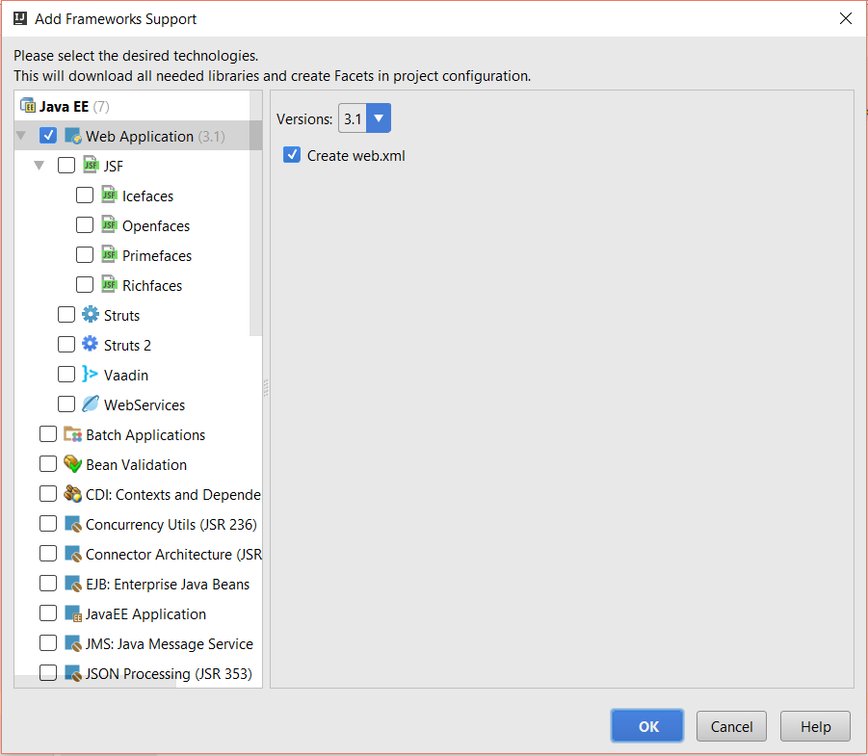
Java EE Support
Web Support
Web XML

Slide 22
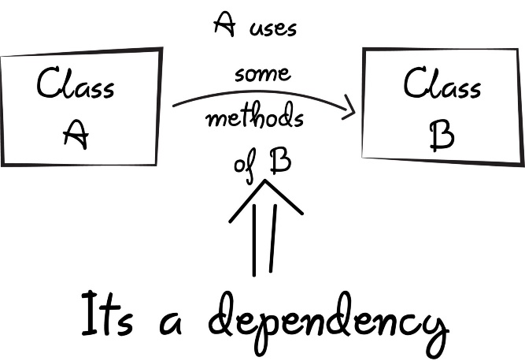
Context & Dependency Injection

Slide 23
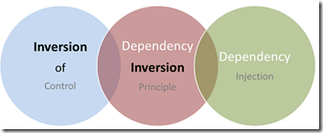
CDI(1)
CDI, or Context & Dependency Injection:
Key Java EE specification
Triggered when components are packaged
Bean Manager:
Discovers these components
Spots the dependencies between them
Injects the right reference into the right beans

Slide 24

CDI(2)
After deployment:
All beans are connected
CDI Bean:
Just an object
Managed by the bean manager

Slide 25

Java Servlets

Slide 26
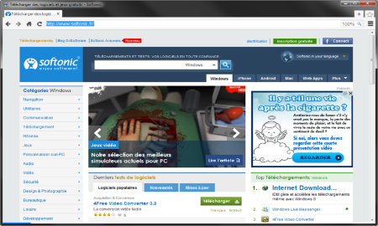
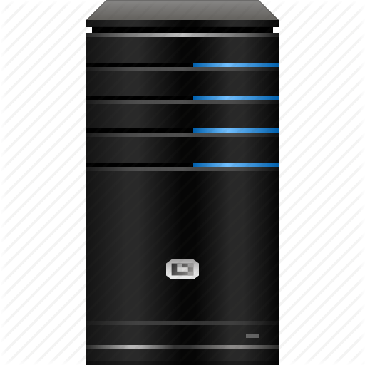




Java Servlets
Programs that run on a Web/Application server
Extend the capabilities of a Server
Able to respond to any type of request
Web Client
Web Server
Request
Request
Servlet
Database
Data
Response
Response

Slide 27
Servlet Example
Servlet.java
URL pattern
@WebServlet("/home")
public class Servlet extends HttpServlet {
protected void doPost(HttpServletRequest request,
HttpServletResponse response)
throws ServletException, IOException {
}
protected void doGet(HttpServletRequest request,
HttpServletResponse response)
throws ServletException, IOException {
}
}
Handle Post requests
Handle Get requests

Slide 28
Servlet Lifecycle
Java Virtual Machine
Web Server
Servlet Container
Thread 1
init()
Thread 2
service()
Thread 3
destroyed()
Requests

Slide 29
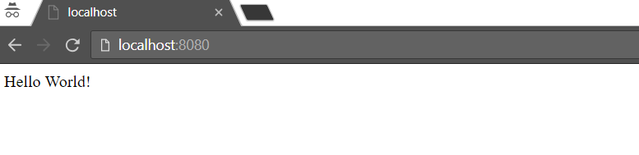
Hello World!
Servlet.java
@WebServlet("/")
public class Servlet extends HttpServlet {
protected void doGet(…) {
PrintWriter out = response.getWriter();
out.println("Hello World!");
}
}

Slide 30
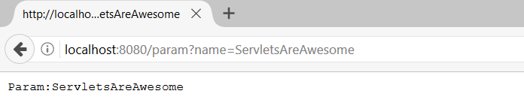
Read Parameter
Servlet.java
@WebServlet("/param")
public class Servlet extends HttpServlet {
protected void doGet(…) {
PrintWriter out = response.getWriter();
String name = request.getParameter("name");
out.println("Param:" + name);
}
}
Param name
Param name

Slide 31
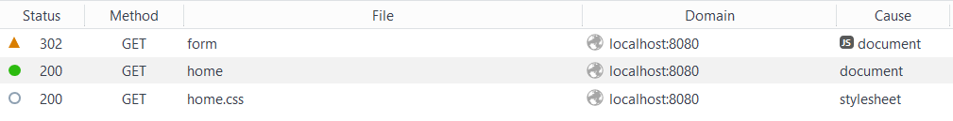
Redirect
Servlet.java
@WebServlet("/form")
public class Servlet extends HttpServlet {
protected void doGet(…) {
response.sendRedirect("/home"); }
}
Redirect to /home
Notes:
It is possible to invalidate a cookie by invoking the method languageCookie.setMaxAge(0);

Slide 32
Inject Beans(1)
beans.xml
<?xml version="1.0" encoding="UTF-8"?>
<beans
xmlns="http://xmlns.jcp.org/xml/ns/javaee"
xmlns:xsi="http://www.w3.org/2001/XMLSchema-instance"
xsi:schemaLocation="http://xmlns.jcp.org/xml/ns/javaee
http://xmlns.jcp.org/xml/ns/javaee/beans_1_1.xsd"
bean-discovery-mode="all">
</beans>

Slide 33
Inject Beans(2)
Servlet.java
@WebServlet("/")
public class Servlet extends HttpServlet {
@Inject
private UserService userService;
protected void doGet(…) {
PrintWriter out = response.getWriter();
User user = this.userService
.getUserByUsername(request.getParameter("name"));
out.println(“User:" + user.getName());
}
}

Slide 34



Summary
The Java Technology:
A platform and a programming language
Java EE – The Big Picture:
The Java EE Architecture
What is Apache TomEE?
What is CDI?
What are Servlets?

Slide 35
https://softuni.bg/trainings/courses

Slide 36












SoftUni Diamond Partners

Slide 37

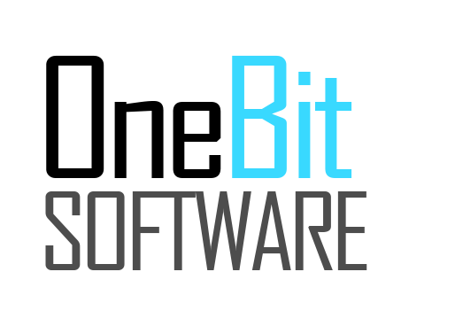


SoftUni Organizational Partners

Slide 38




Trainings @ Software University (SoftUni)
Software University – High-Quality Education and Employment Opportunities
softuni.bg
Software University Foundation
http://softuni.foundation/
Software University @ Facebook
facebook.com/SoftwareUniversity
Software University Forums
forum.softuni.bg

Slide 39

License
This course (slides, examples, demos, videos, homework, etc.) is licensed under the "Creative Commons Attribution-NonCommercial-ShareAlike 4.0 International" license

